Slide 1
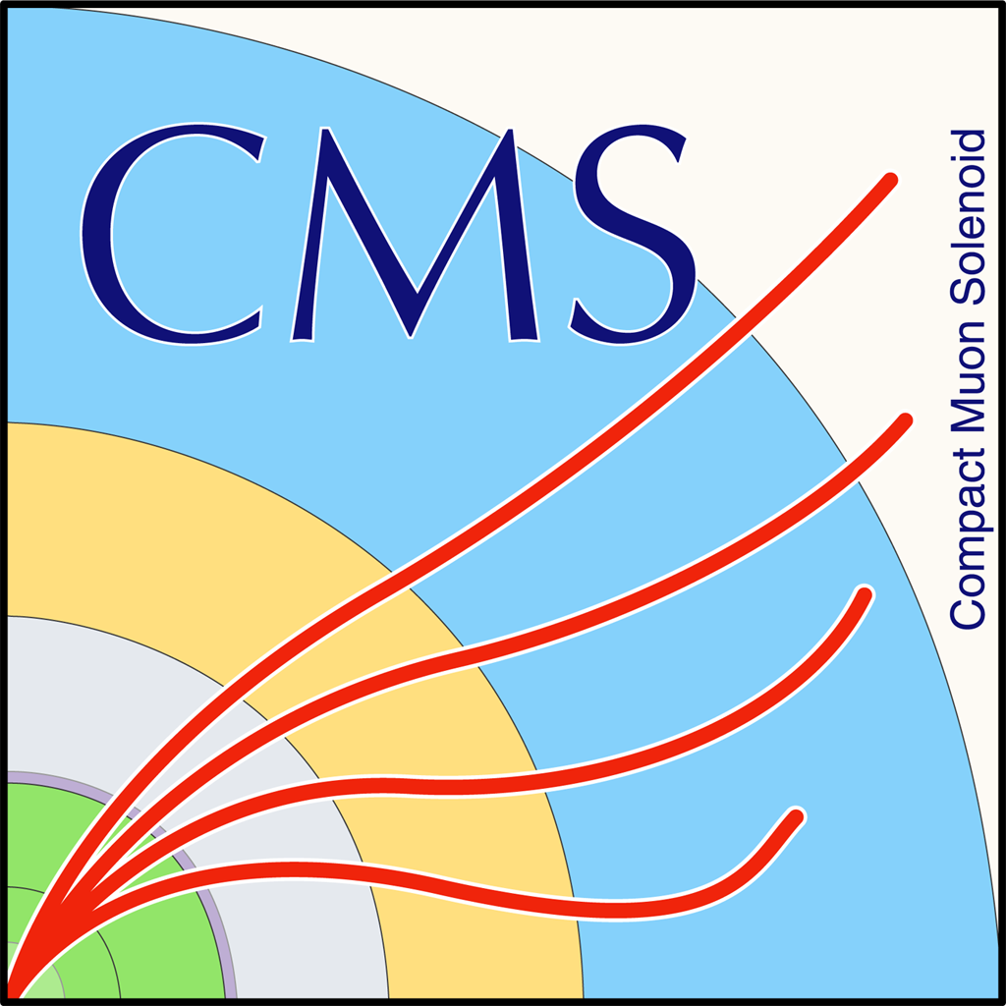

Measurement of differential production cross section for high-pT top quarks in the all hadronic channel Top ttX meeting
G. Bakas, K. Kousouris, I. Papakrivopoulos, G. Tsipolitis

Slide 2
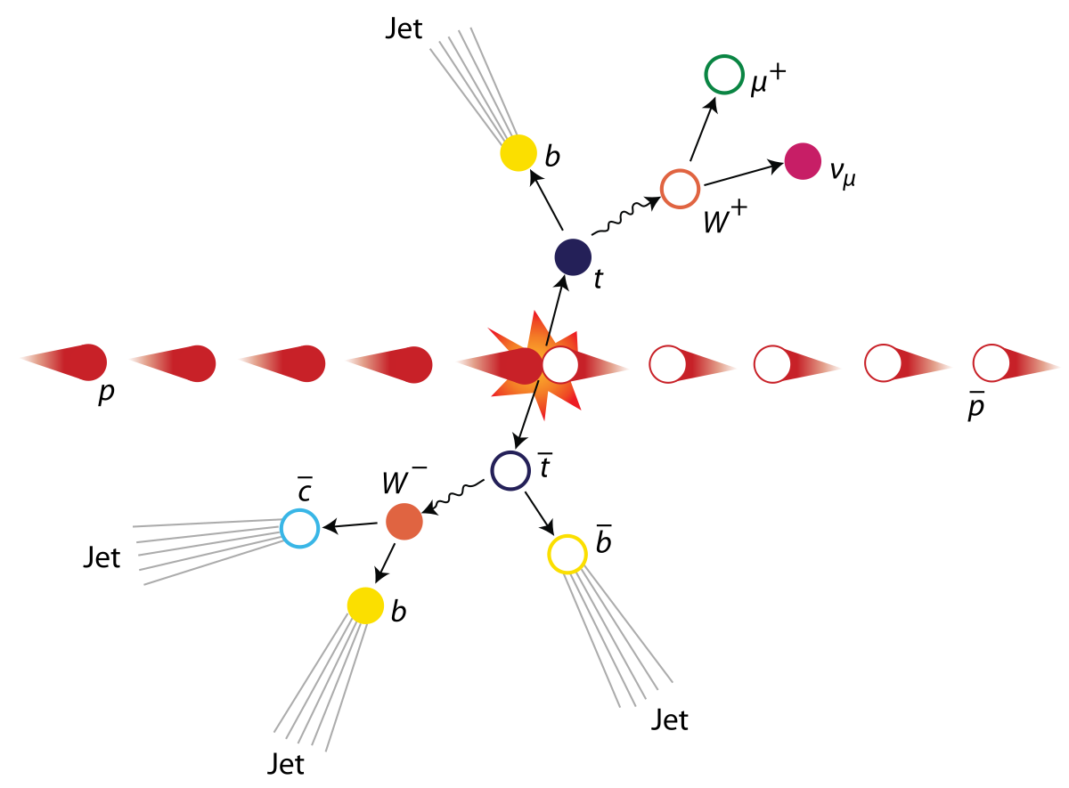
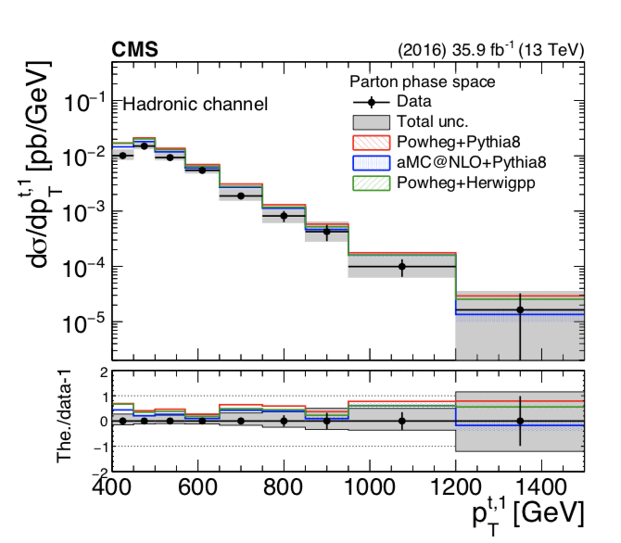
Motivation
Top, anti-top production in the fully hadronic
final state.
Trying to identify two big jets that contain the
products of the top/anti-top decay.

Slide 3
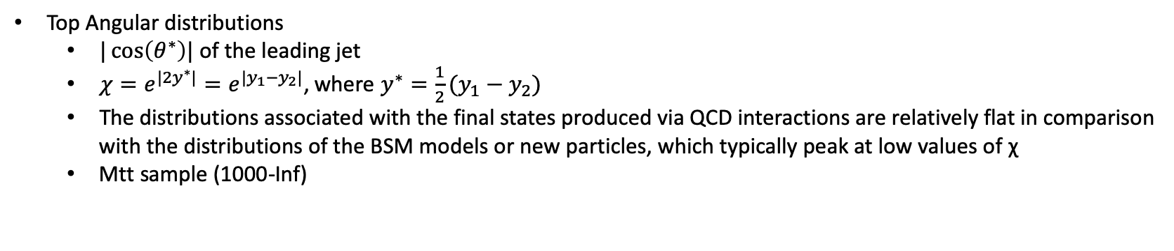
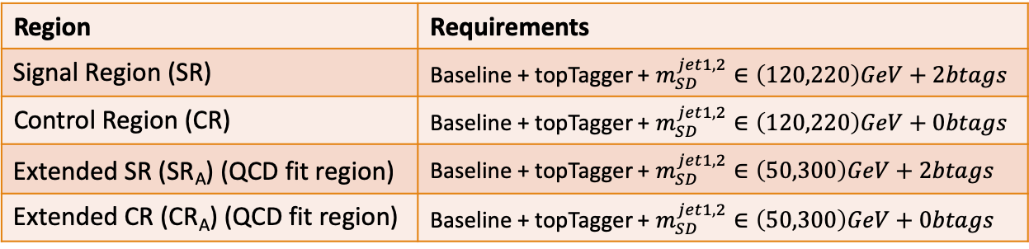
Overview
Variables of interest:
ttbar mass, pt, rapidity
Leading and Subleading jetPt and |jetY|
Mtt samples (700-1000, 1000-Inf)
Region | Requirements
Signal Region (SR) | Baseline + topTagger + $m_{SD}^{jet1,2}∈\left(120,220\right)GeV+2btags$
Control Region (CR) | Baseline + topTagger + $m_{SD}^{jet1,2}∈\left(120,220\right)GeV+0btags$
Extended SR (SR_{A}) (QCD fit region) | Baseline + topTagger + $m_{SD}^{jet1,2}∈\left(50,300\right)GeV+2btags$
Extended CR (CR_{A}) (QCD fit region) | Baseline + topTagger + $m_{SD}^{jet1,2}∈\left(50,300\right)GeV+0btags$
Top Angular distributions
$|\cos\left(θ^{∗}\right)|$ of the leading jet
$χ=e^{{|2y}^{∗}|}=e^{|y_{1}−y_{2}|}$, where $y^{∗}=\frac{1}{2}(y_{1}−y_{2})$
The distributions associated with the final states produced via QCD interactions are relatively flat in comparison with the distributions of the BSM models or new particles, which typically peak at low values of χ
Mtt sample (1000-Inf)
Baseline Parton cuts:
Jet Matching
partonPt[0],[1] > 400
|partonEta[0],[1]| < 2.4
mTTbarParton > 1000
Baseline Reconstructed level cuts:
nJets > 1
nLeptons = 0
Dijet mass (mJJ) > 1000
Leading and Subleading jet p_{T} > 400
Leading and Subleading absolute jet eta |η|<2.4
Trigger
Btagging selection:
bTagging (medium WP deepCSV) (2016: 0.6321, 2017: 0.4941, 2018: 0.4184)
Top Tagger WP:
New top Tagger: (2016: 0.2, 2017:0.0, 2018: 0.1)

Slide 4
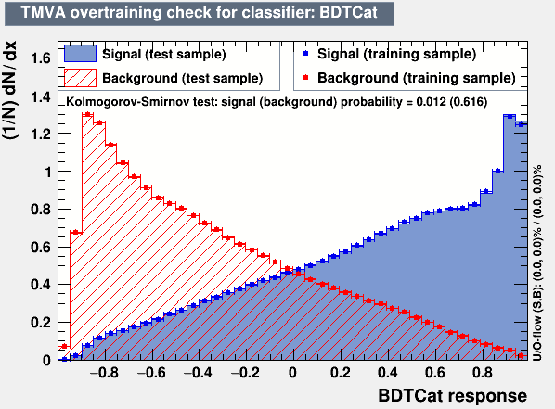
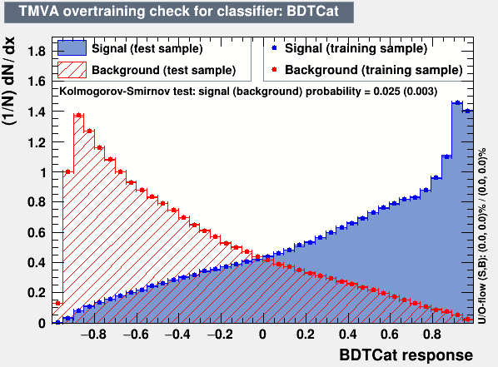
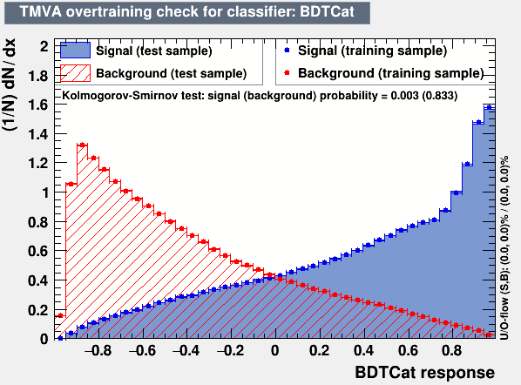
Overview: Discriminator, Efficiency and Acceptance
2016
The discriminator is a BDT trained individually for 2016, 2017 and 2018
Category training: split the sample in categories based on Pt
Bins:
[400, 600] GeV
[600, 800] GeV
[800, 1200] GeV
[1200, inf) GeV
BDT, used variables:
Leading and Sub-leading subjet mass
N-Subjetiness variables (tau1, tau2, tau3)
fraction of the jetPt over the total pt sum of the event.
Energy correlation functions (ecfB1N2,ecfB1N3, ecfB2N2, ecfB2N3)
BDT Output consistency for the 3 years
Calculation of Efficiency and acceptance for each year
We choose the WP’s for each year so that the leading jet p_{T} efficiency is similar for all years
2017
2018

Slide 5
Efficiency and Acceptance for 2016, 2017 and 2018 and previous 2016 analysis

Slide 6
Btagging efficiency in eta, pT_{subJet} phase space
2016
2017

Slide 7
Btagging efficiency in eta, pT_{subJet} phase space
2018
2017

Slide 8
Efficiency, Acceptance for χ

Slide 9
Efficiency, Acceptance for |cos(θ*)|

Slide 10
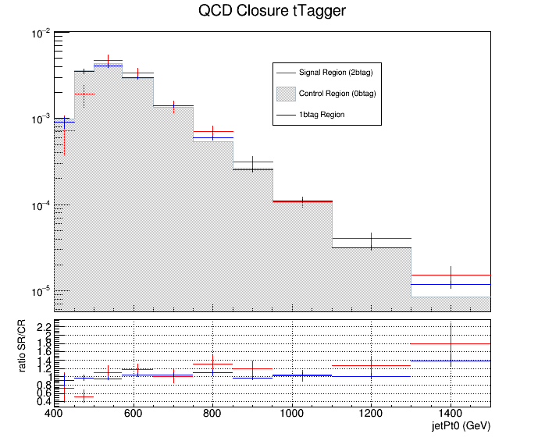
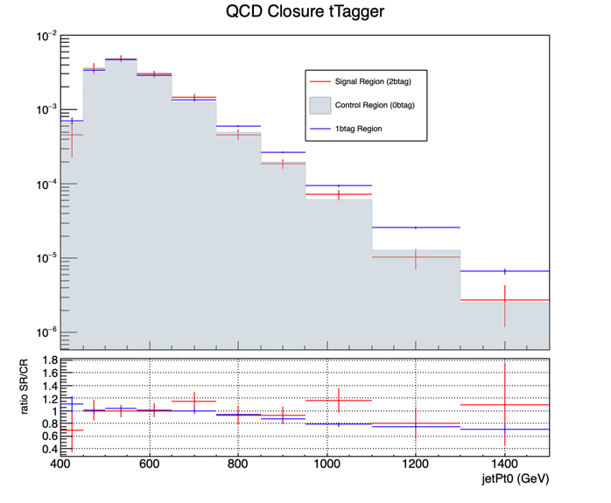
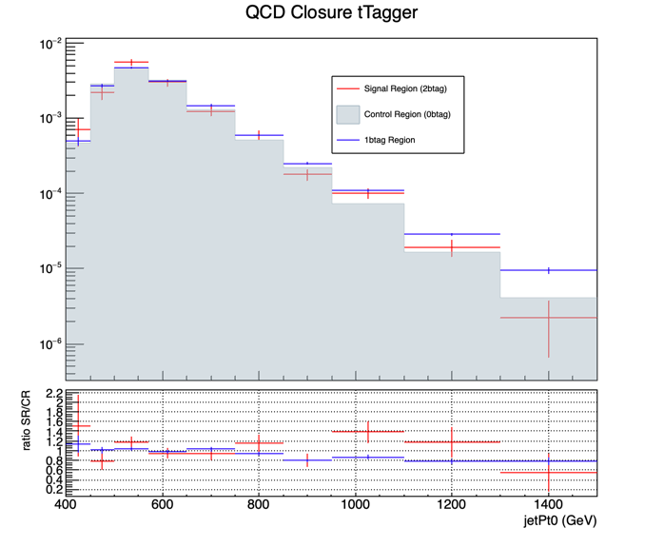
QCD Closure Tests ’16, ‘17, ’18 jetPt0
2016
2017
2018

Slide 11
QCD Closure Tests ’16, ‘17, ’18 χ
2016
2017
2018

Slide 12
QCD Closure Tests ’16, ‘17, ’18 |cos(θ*)|
2016
2017
2018

Slide 13
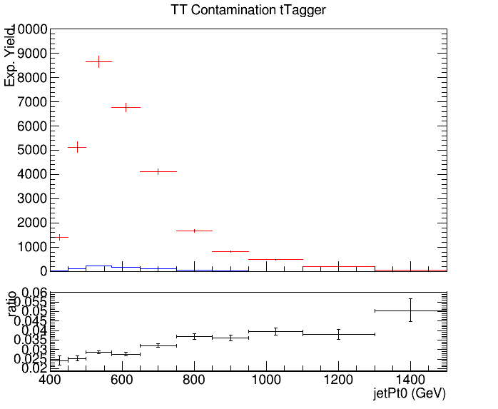
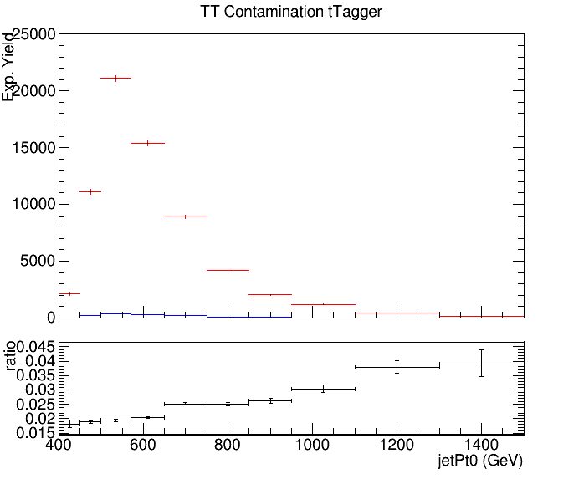
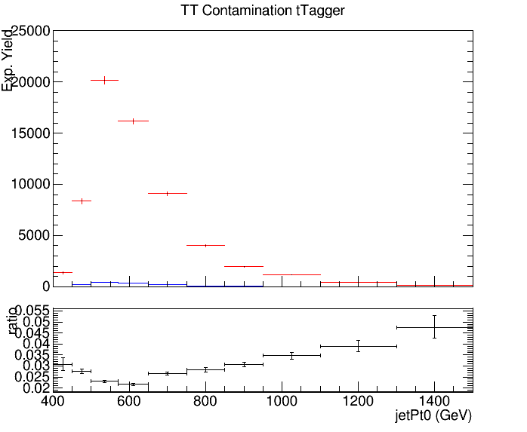
CR Contamination ’16,’17,’18 jetPt0
Control Region QCD sample
Control Region TT sample
2016
2017
2018

Slide 14
CR Contamination ’16,’17,’18 χ
Control Region QCD sample
Control Region TT sample
2016
2017
2018

Slide 15
CR Contamination ’16,’17,’18 |cos(θ*)|
Control Region QCD sample
Control Region TT sample
2016
2017
2018

Slide 16
Signal Extraction
Fitted number of QCD events in SR_{A}
Measured dist from data
QCD shape taken from Data (CR)
$$S\left(x_{reco}\right)=D\left(x_{reco}\right)−C_{bkg}^{yield}N_{QCD}^{fit}C_{QCD}^{shape}\left(x_{reco}\right)Q\left(x_{reco}\right)−B(x_{reco})$$
Fiducial Yield
Transfer factor from SR_{A} to SR
QCD shape correction factor
Subdominant bkg shape and contribution (MC)
Where x_{reco} is the respected variable of interest (ttbar mass,pt, rapidity, leading and subleading jetPt and |jetY|)
We deploy a simultaneous fit in 3 regions (0,1,2 btag) because we do not have a pure Control Region.
Our data CR is ttbar contaminated
$$D{\left(m^{t}\right)}^{(i)}=N_{tt}^{(i)}T^{(i)}\left(m^{t},k_{MassScale}, k_{MassResolution}\right)+N_{bkg}^{(i)}B\left(m^{t} \right)\left(1+k_{1}x\right)+N_{sub}^{(i)}O^{(i)}\left(m^{t}\right)$$
We assume that $N_{tt}^{(0)}={\left(1−e_{b}\right)}^{2}N_{tt}, N_{tt}^{(2)}=e_{b}^{2}N_{tt} and N_{tt}^{(1)}=2\left(1−e_{b}\right)e_{b}N_{tt}$ where e_{b} is the b tagging efficiency and N_{tt} is the total ttbar yield.

Slide 17
Simultaneous Fit in 3 regions for 2016, 2017, 2018 when eb is free (SR)
Signal Region (2btag) (2016)
Signal Region (2btag) (2017)
Signal Region (2btag) (2018)
Result of the simultaneous fit on data in SR. The red line shows the ttbar contribution, the green line shows the QCD, and the black line shows the subdominant backgrounds

Slide 18
Simultaneous Fit in 3 regions for 2016, 2017, 2018 when eb is free (CR)
Control Region (0btag) (2016)
Control Region (0btag) (2017)
Control Region (0btag) (2018)
Result of the simultaneous fit on data in CR. The red line shows the ttbar contribution, the green line shows the QCD, and the black line shows the subdominant backgrounds

Slide 19
Simultaneous Fit in 3 regions for 2016, 2017, 2018 when eb is free (1btag region)
1btag region (2016)
1btag region (2017)
1btag region (2018)
Result of the simultaneous fit on data in 1btag region. The red line shows the ttbar contribution, the green line shows the QCD, and the black line shows the subdominant backgrounds

Slide 20
We are checking for different values of e_{b}, the output of the N⁽²⁾_{QCD} for 2016 , 2017, 2018
The values of e_{b} are picked when the fit output is efficient
Calculated btagging efficiency for all years
btagging efficiency when the parameter is set as a free nuisance in the simultaneous fit
2016: eb (fit) ≈ 0.61 and eb (calculated) ≈0.63
2017: eb(fit) ≈ 0.55 and eb (calculated) ≈ 0.61
2018: eb(fit) ≈ 0.57 and eb (calculated) ≈ 0.63
Stable results (within error) of N⁽²⁾_{QCD} for a variety of b-tagging efficiency values
2016
2017
2018
e_{b} from fit
e_{b} from fit
e_{b} calculated
e_{b} from fit
e_{b} calculated
e_{b} calculated
e_{b} calculated

Slide 21
Summary
Delivered a new top Tagger that discriminates top jets from QCD jets
Efficiencies and Acceptances for measured variables
New variables: top angular
btagging efficiency in the |eta|, pT subjet phase space
QCD Closure tests to ensure that the shape of the QCD in the CR and in SR are consistent
ttbar contamination in the CR for measured variables
Signal Extraction
Fit to extract the N_{QCD} in the extended Signal Region A (SR_{A} )
Simultaneous fit in 3 regions to suppress the ttbar contribution in the CR
Ν_{QCD} not affected from b-tagging efficiency

Slide 22
BACKUP SLIDES

Slide 23
Efficiency and Acceptance for 2016, 2017 and 2018 with no btagging selection

Slide 24
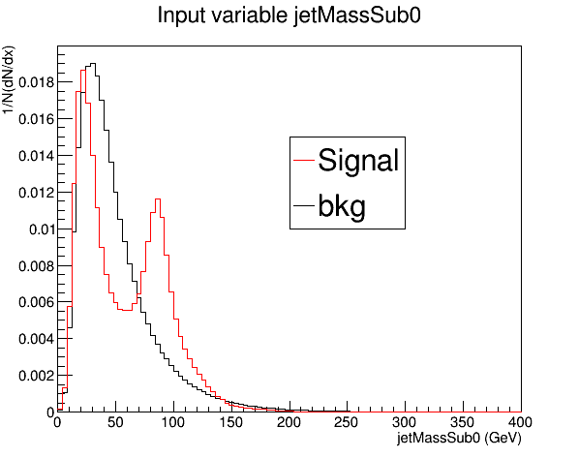
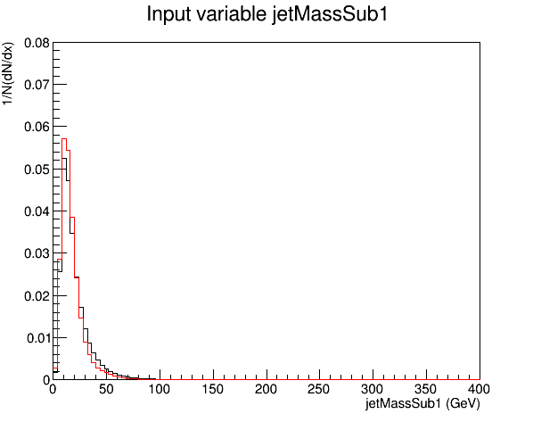
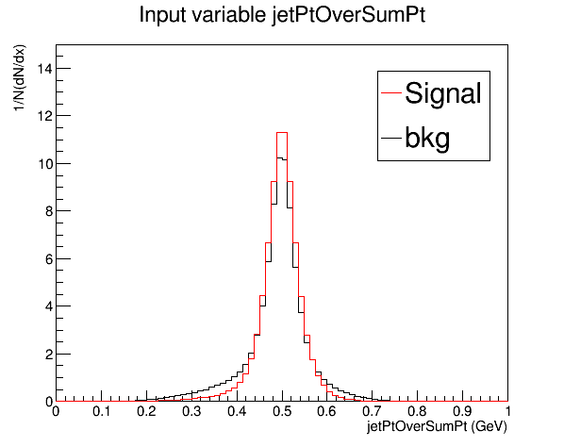
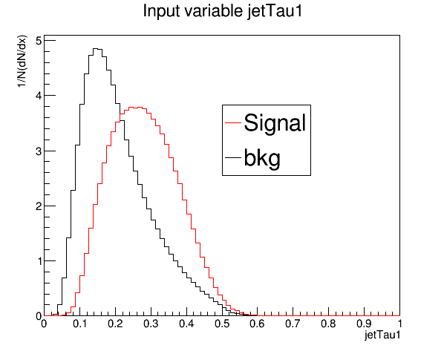
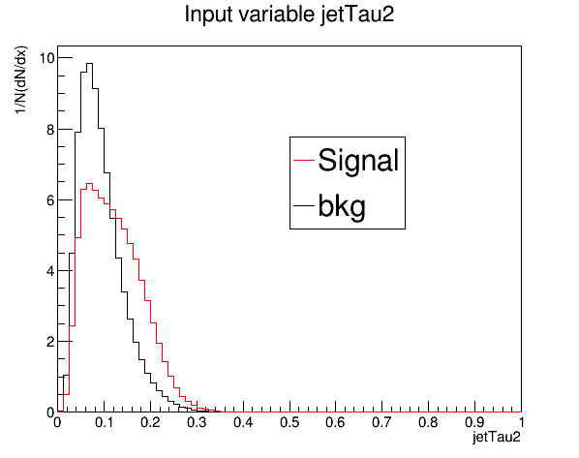
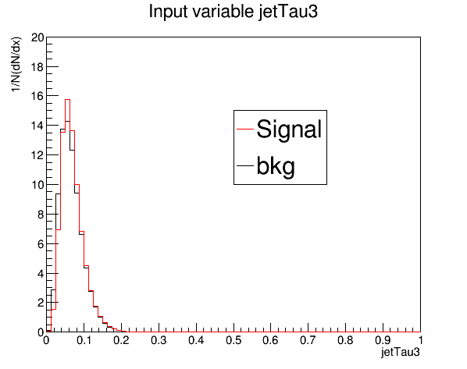
Training variables 2017

Slide 25
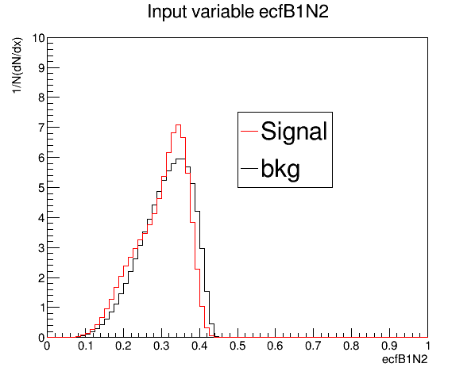
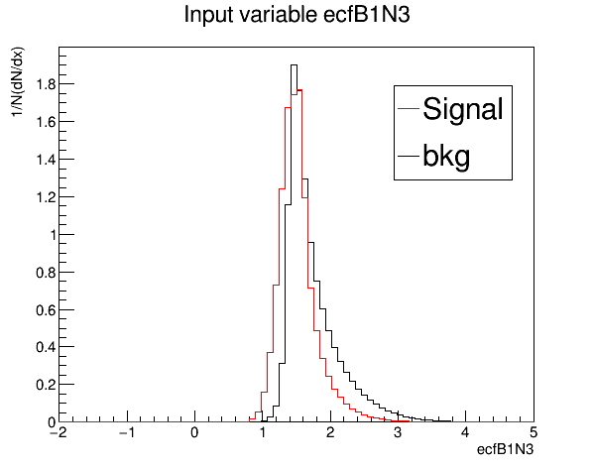
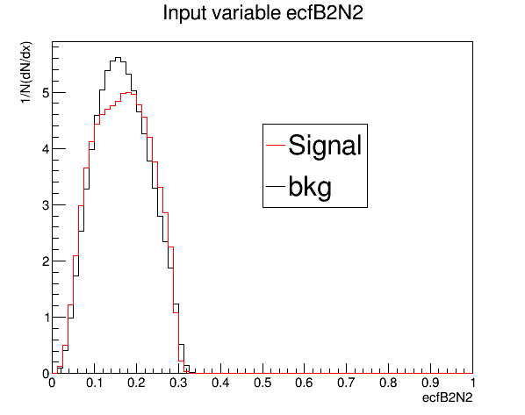
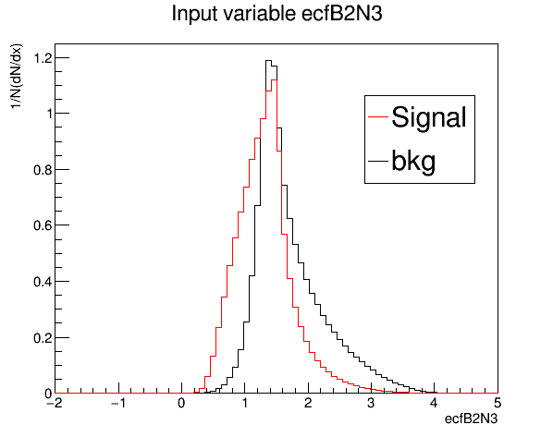
Training variables 2017

Slide 26
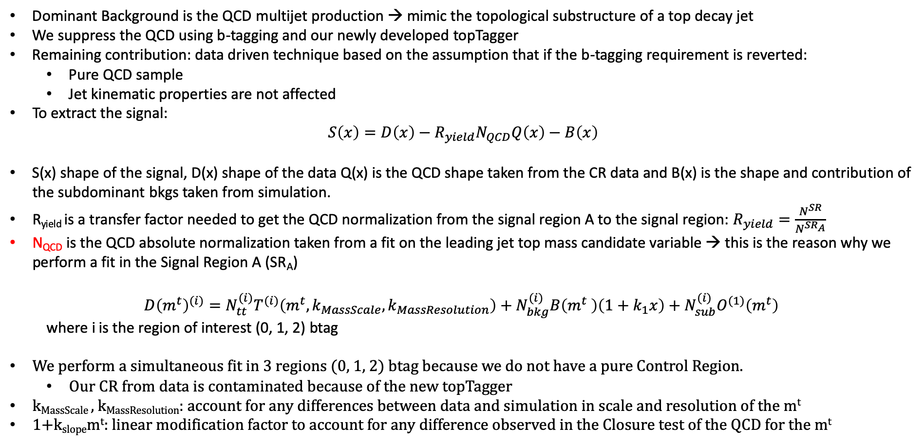
Signal Extraction
Dominant Background is the QCD multijet production → mimic the topological substructure of a top decay jet
We suppress the QCD using b-tagging and our newly developed topTagger
Remaining contribution: data driven technique based on the assumption that if the b-tagging requirement is reverted:
Pure QCD sample
Jet kinematic properties are not affected
To extract the signal:
$$S\left(x\right)=D\left(x\right)−R_{yield}N_{QCD}Q\left(x\right)−B\left(x\right)$$
S(x) shape of the signal, D(x) shape of the data Q(x) is the QCD shape taken from the CR data and B(x) is the shape and contribution of the subdominant bkgs taken from simulation.
R_{yield} is a transfer factor needed to get the QCD normalization from the signal region A to the signal region: $R_{yield}=\frac{N^{SR}}{N^{SR_{A}}}$
N_{QCD} is the QCD absolute normalization taken from a fit on the leading jet top mass candidate variable → this is the reason why we perform a fit in the Signal Region A (SR_{A})
$$D{\left(m^{t}\right)}^{(i)}=N_{tt}^{(i)}T^{(i)}\left(m^{t},k_{MassScale}, k_{MassResolution}\right)+N_{bkg}^{(i)}B\left(m^{t} \right)\left(1+k_{1}x\right)+N_{sub}^{(i)}O^{(1)}\left(m^{t}\right)$$
where i is the region of interest (0, 1, 2) btag
We perform a simultaneous fit in 3 regions (0, 1, 2) btag because we do not have a pure Control Region.
Our CR from data is contaminated because of the new topTagger
k_{MassScale} , k_{MassResolution}: account for any differences between data and simulation in scale and resolution of the m^{t}
1+k_{slope}m^{t}: linear modification factor to account for any difference observed in the Closure test of the QCD for the m^{t}

Slide 27
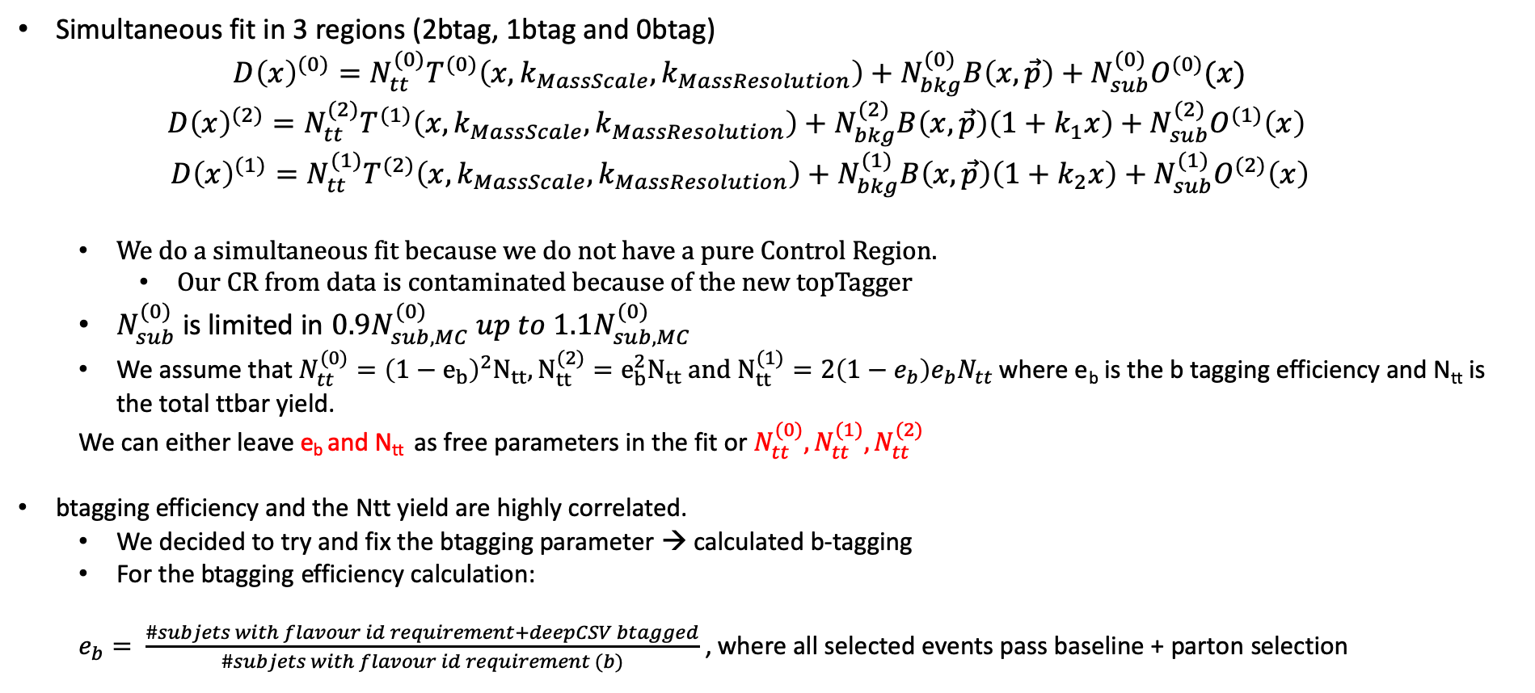
Simultaneous Fit in 3 regions
Simultaneous fit in 3 regions (2btag, 1btag and 0btag)
$$D{\left(x\right)}^{(0)}=N_{tt}^{(0)}T^{(0)}\left(x, k_{MassScale}, k_{MassResolution}\right)+N_{bkg}^{(0)}B\left(x,\vec{p}\right)+N_{sub}^{(0)}O^{(0)}(x)$$
$$D{\left(x\right)}^{(2)}=N_{tt}^{(2)}T^{(1)}\left(x,k_{MassScale}, k_{MassResolution}\right)+N_{bkg}^{(2)}B\left(x,\vec{p}\right)\left(1+k_{1}x\right)+N_{sub}^{(2)}O^{(1)}\left(x\right)$$
$$D{\left(x\right)}^{(1)}=N_{tt}^{(1)}T^{(2)}\left(x,k_{MassScale}, k_{MassResolution}\right)+N_{bkg}^{(1)}B\left(x,\vec{p}\right)\left(1+k_{2}x\right)+N_{sub}^{(1)}O^{(2)}\left(x\right)$$
We do a simultaneous fit because we do not have a pure Control Region.
Our CR from data is contaminated because of the new topTagger
$N_{sub}^{(0)}$ is limited in $0.9N_{sub,MC}^{(0)} up to 1.1N_{sub,MC}^{(0)}$
We assume that $N_{tt}^{(0)}={\left(1−e_{b}\right)}^{2}N_{tt}, N_{tt}^{(2)}=e_{b}^{2}N_{tt} and N_{tt}^{(1)}=2\left(1−e_{b}\right)e_{b}N_{tt}$ where e_{b} is the b tagging efficiency and N_{tt} is the total ttbar yield.
We can either leave e_{b} and N_{tt} as free parameters in the fit or $N_{tt}^{(0)},N_{tt}^{(1)},N_{tt}^{(2)}$
btagging efficiency and the Ntt yield are highly correlated.
We decided to try and fix the btagging parameter → calculated b-tagging
For the btagging efficiency calculation:
$e_{b}= \frac{\#subjets with flavour id requirement+deepCSV btagged}{\#subjets with flavour id requirement (b)}$ , where all selected events pass baseline + parton selection

Slide 28
Btagging purity
2016
2017
2018
Purity ≈ 0. 894
Purity ≈ 0.915
Purity ≈ 0.903

Slide 29
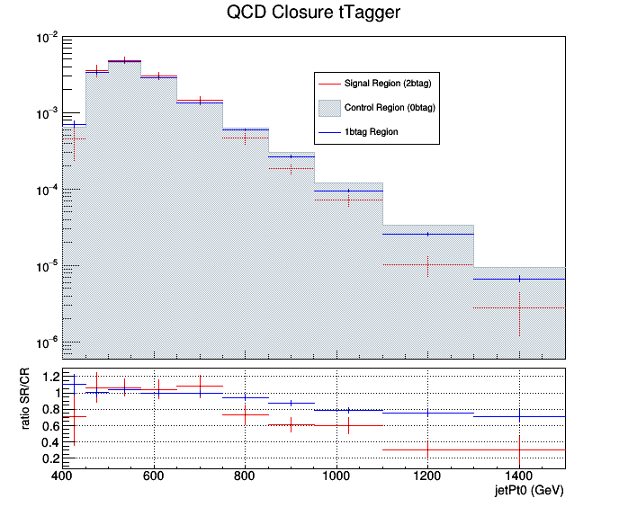
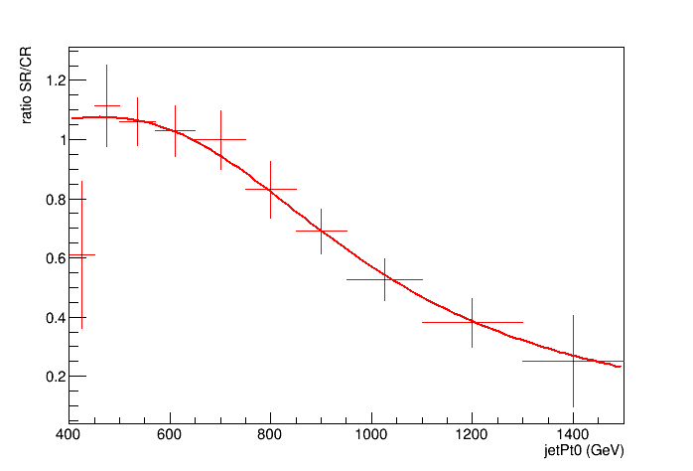
2017 QCD Closure and the fit ratio
Discovered shape in the SR/CR
Fit the ratio
Output of the new QCD closure

Slide 30
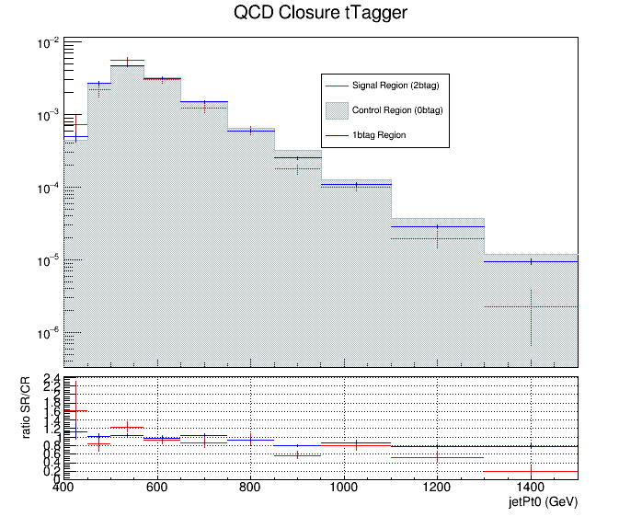
2018 QCD Closure and the fit ratio
Discovered shape in the SR/CR
Fit the ratio
Output of the new QCD closure

Slide 31
2016
Template fit results Signal Region A
1btag region
0btag region
2btag region
2017

Slide 32
Template fit results Signal Region A
2018
1btag region
0btag region
2btag region

Slide 33
2016
2017
2018

Slide 34
Simultaneous Fit in 3 regions for 2016 ,2017 and 2018 (nuisances) with free eb
2016
2017
2018
Floating Parameter FinalValue +/- Error
-------------------- --------------------------
btagEff 6.0786e-01 +/- 1.53e-02
kMassResol 9.5079e-01 +/- 2.42e-02
kMassScale 1.0009e+00 +/- 1.76e-03
kQCD_1b 6.0406e-03 +/- 5.05e-04
kQCD_2b 9.6764e-02 +/- 6.83e-02
nFitBkg_0b 4.5268e+03 +/- 6.84e+02
nFitBkg_1b 1.9110e+03 +/- 3.13e+02
nFitBkg_2b 1.9415e+02 +/- 2.48e+01
nFitQCD_0b 8.8132e+04 +/- 4.48e+02
nFitQCD_1b 3.0796e+04 +/- 4.61e+02
nFitQCD_2b 3.0802e+03 +/- 1.45e+02
nFitSig 1.4153e+04 +/- 7.33e+02
qcd_b0 6.6661e-01 +/- 5.74e-01
qcd_b1 1.4002e+00 +/- 1.62e+00
qcd_b2 3.3898e-02 +/- 5.46e-02
qcd_b3 3.3916e-02 +/- 3.37e-02
qcd_b4 1.6260e-02 +/- 1.52e-02
qcd_f1 6.9097e-01 +/- 2.57e-02
qcd_mean 1.5055e+02 +/- 1.05e+00
qcd_sigma 3.3739e+01 +/- 1.30e+00
Floating Parameter FinalValue +/- Error
-------------------- --------------------------
btagEff 5.4097e-01 +/- 1.39e-02
kMassResol 1.0289e+00 +/- 3.03e-02
kMassScale 9.8332e-01 +/- 2.06e-03
kQCD_1b 4.2097e-03 +/- 3.15e-04
kQCD_2b 1.5460e-02 +/- 5.16e-03
nFitBkg_0b 4.0852e+03 +/- 5.03e+02
nFitBkg_1b 1.6992e+03 +/- 2.84e+02
nFitBkg_2b 2.1330e+02 +/- 4.44e+01
nFitQCD_0b 1.5483e+05 +/- 5.41e+02
nFitQCD_1b 3.7067e+04 +/- 4.57e+02
nFitQCD_2b 2.4652e+03 +/- 1.32e+02
nFitSig 1.5594e+04 +/- 7.87e+02
qcd_b0 5.2866e-01 +/- 8.49e-02
qcd_b1 1.1003e+00 +/- 1.63e-01
qcd_b2 8.4662e-02 +/- 3.49e-02
qcd_b3 5.5285e-02 +/- 1.06e-02
qcd_b4 1.9483e-02 +/- 3.70e-03
qcd_f1 7.1106e-01 +/- 1.24e-02
qcd_mean 1.5184e+02 +/- 6.37e-01
qcd_sigma 3.2820e+01 +/- 6.76e-01
Floating Parameter FinalValue +/- Error
-------------------- --------------------------
btagEff 5.7371e-01 +/- 1.12e-02
kMassResol 1.0251e+00 +/- 2.43e-02
kMassScale 9.8728e-01 +/- 1.61e-03
kQCD_1b 3.6804e-03 +/- 2.60e-04
kQCD_2b 1.3533e-02 +/- 3.24e-03
nFitBkg_0b 4.1842e+03 +/- 5.05e+02
nFitBkg_1b 2.1675e+03 +/- 3.15e+02
nFitBkg_2b 3.4159e+02 +/- 7.52e+01
nFitQCD_0b 1.6842e+05 +/- 5.64e+02
nFitQCD_1b 4.9321e+04 +/- 5.36e+02
nFitQCD_2b 4.4306e+03 +/- 1.77e+02
nFitSig 2.2906e+04 +/- 8.92e+02
qcd_b0 4.0935e-01 +/- 6.23e-02
qcd_b1 8.5950e-01 +/- 1.25e-01
qcd_b2 1.0234e-01 +/- 2.32e-02
qcd_b3 2.4955e-02 +/- 6.63e-03
qcd_b4 1.1844e-02 +/- 2.02e-03
qcd_f1 7.3124e-01 +/- 1.01e-02
qcd_mean 1.5274e+02 +/- 5.33e-01
qcd_sigma 3.1322e+01 +/- 6.11e-01
Ntt expected: 16351
Ntt observed: 14153
Signal strength r: 0.865584
Ntt expected: 23721
Ntt observed: 15594
Signal strength r: 0.657402
Ntt expected: 30676
Ntt observed: 22906
Signal strength r: 0.746688

Slide 35
Correlation plots N_{QCD(2)} vs all nuisances from fit when eb runs free for 2016

Slide 36
Correlation plots N_{QCD(2)} vs all nuisances from fit when eb runs free for 2016

Slide 37
Correlation plots N_{QCD(2)} vs all nuisances from fit when eb runs free for 2017

Slide 38
Correlation plots N_{QCD(2)} vs all nuisances from fit when eb runs free for 2017

Slide 39
Correlation plots N_{QCD(2)} vs all nuisances from fit when eb runs free for 2018

Slide 40
Correlation plots N_{QCD(2)} vs all nuisances from fit when eb runs free for 2018

